Slide 1
Object Oriented Programming—C++ Lecture4 Streams & Containers
Qijun Zhao
College of Computer Science
Sichuan University
Spring 2023

Slide 2
Recap
- Uniform Initialization
- A “uniform” way to initialize variables of different types!
- References
- Allow us to alias variables
- Const
- Allow us to specify that a variable can’t be modified

Slide 3
Streams

Slide 4
Streams
- What are streams?
- Output streams
- Input streams
- String streams!

Slide 5
Definition
stream: an abstraction for input/output. Streams convert between data and the string representation
of data.

Slide 6
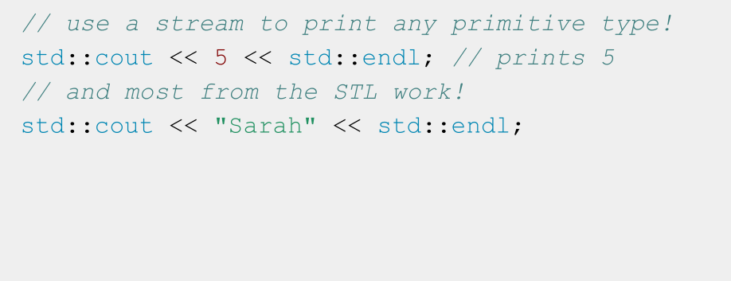
A stream you’ve used: cout

Slide 7
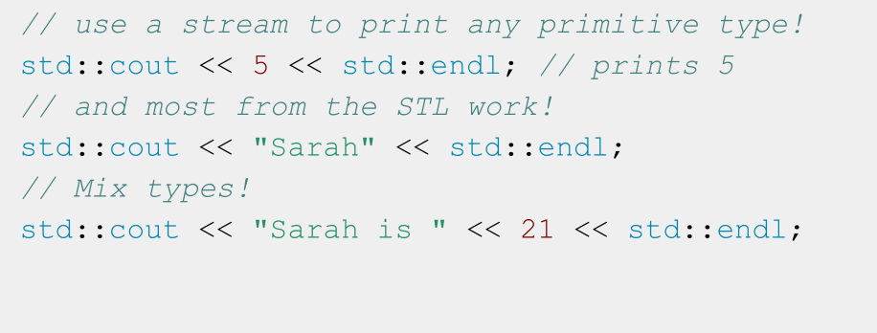
A stream you’ve used: cout

Slide 8
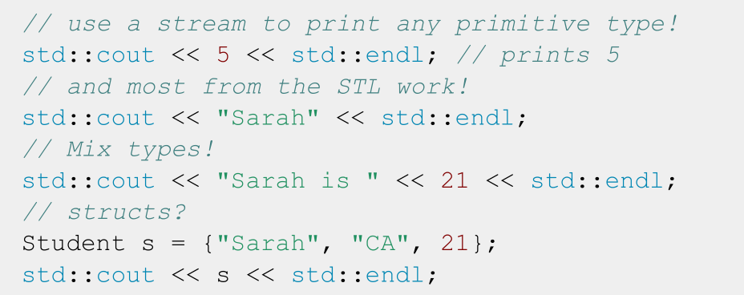
A stream you’ve used: cout

Slide 9
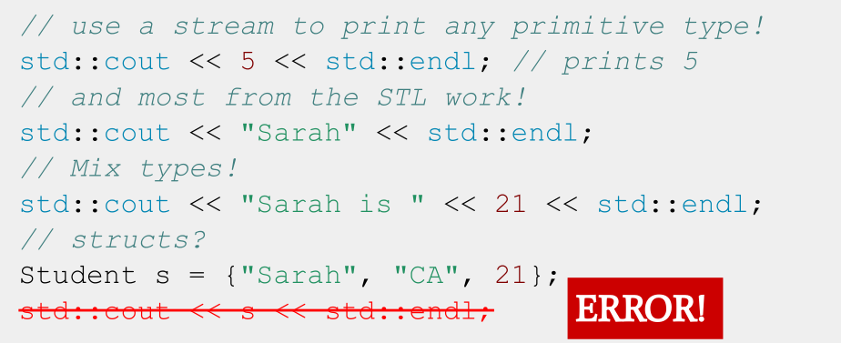
A stream you’ve used: cout

Slide 10
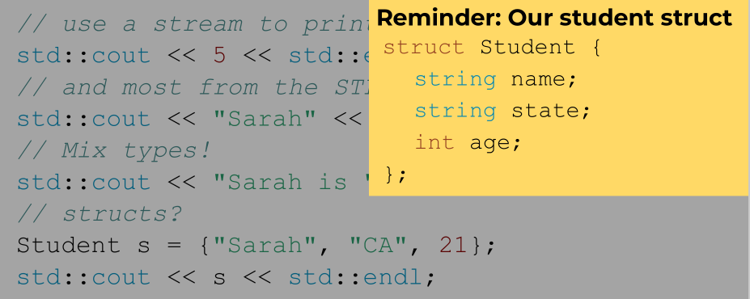
A stream you’ve used: cout

Slide 11
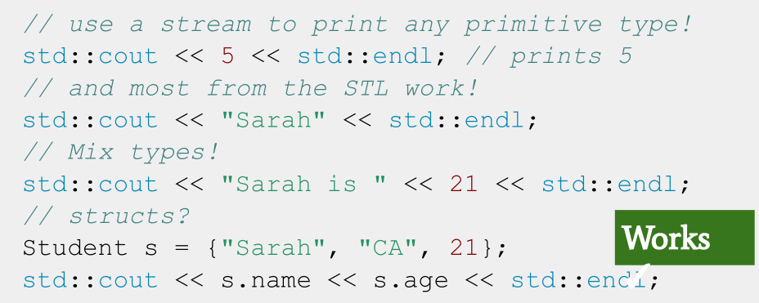
A stream you’ve used: cout

Slide 12
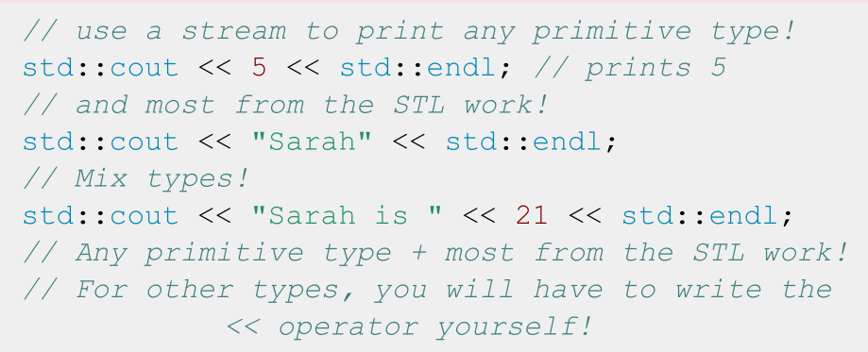
A stream you’ve used: cout
We’ll talk about how to write the << operator for custom types during lecture on Operators!

Slide 13
std::cout is an output
stream. It has type
std::ostream

Slide 14
Two ways to classify streams
By Direction:
By Source or Destination:
● Input streams: Used for
reading data (ex. ‘std::istream’,
‘std::cin’)
● Output streams: Used for
writing data (ex. ‘std::ostream’, ‘std::cout’)
● Input/Output streams: Used
for both reading and writing data (ex. ‘std::iostream’,
‘std::stringstream’)
● Console streams: Read/write to
console (ex. ‘std::cout’, ‘std::cin’)
● File streams: Read/write to files
(ex. ‘std::fstream’, ‘std::ifstream’,
‘std::ofstream’)
● String streams: Read/write to
strings (ex. ‘std::stringstream’,
‘std::istringstream’,
‘std::ostringstream’)

Slide 15
Streams
- What are streams?
- Output streams
- Input streams
- String streams!

Slide 16
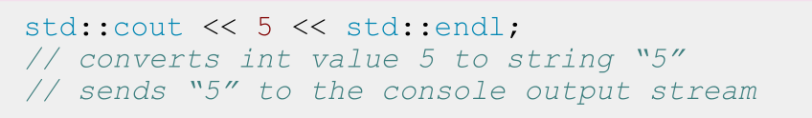
Output Streams
- Have type std::ostream
- Can only send data to the stream
- Interact with the stream using the << operator
- Convert any type into string and send it to the
stream
- std::cout is the output stream that goes to the console

Slide 17
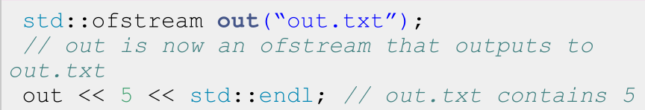
Output File Streams
- Have type std::ofstream
- Only send data using the << operator
- Convert data of any type into a string and send it to the file stream
- Must initialize your own ofstream object linked to your file

Slide 18
std::cout is a global constant object that you get from
#include <iostream>
To use any other output stream,
you must first initialize it!

Slide 19
Streams
- What are streams?
- Output streams
- Input streams
- String streams!

Slide 20
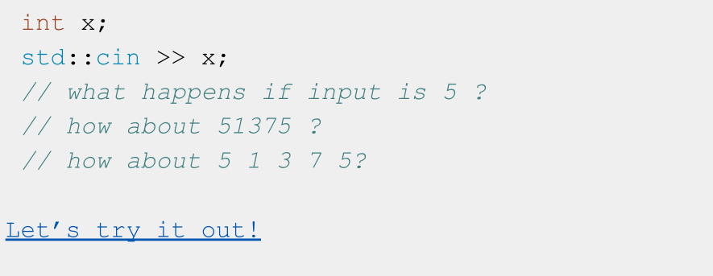
What does this code do?

Slide 21
A note about nomenclature
● “>>” is the stream extraction operator or simply extraction operator
○ Used to extract data from a stream and place it into a variable
● “<<” is the stream insertion operator or insertion operator
○ Used to insert data into a stream usually to output the data to a file, console, or string

Slide 22
std::cin is an input
stream. It has type
std::istream

Slide 23
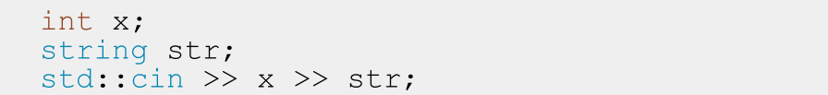
Input Streams
- Have type std::istream
- Can only receive strings using the >> operator
- Receive a string from the stream and convert it to data
- std::cin is the input stream that gets input from the console

Slide 24
Nitty Gritty Details: std::cin
- First call to std::cin >> creates a command line prompt that allows the user to type until they hit enter
- Each >> ONLY reads until the next whitespace
- Whitespace = tab, space, newline
- Everything after the first whitespace gets saved and used the next time std::cin >> is called
- The place its saved is called a buffer!
- If there is nothing waiting in the buffer, std::cin >> creates a new command line prompt
- Whitespace is eaten; it won’t show up in output

Slide 25
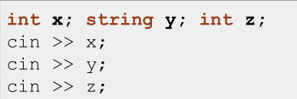
Think of a std::istream as a sequence of characters
4 | 2 |  | a | b |  | 4 | \n
position

Slide 26
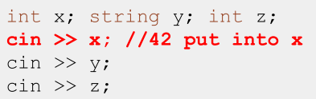
Think of a std::istream as a sequence of characters
4 | 2 |  | a | b |  | 4 | \n
position

Slide 27
Think of a std::istream as a sequence of characters
4 | 2 |  | a | b |  | 4 | \n
position

Slide 28
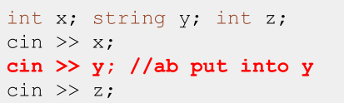
Think of a std::istream as a sequence of characters
4 | 2 |  | a | b |  | 4 | \n
position

Slide 29
Think of a std::istream as a sequence of characters
4 | 2 |  | a | b |  | 4 | \n
position

Slide 30
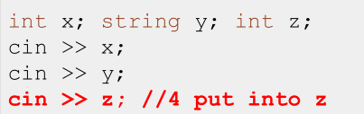
Think of a std::istream as a sequence of characters
4 | 2 |  | a | b |  | 4 | \n
position

Slide 31
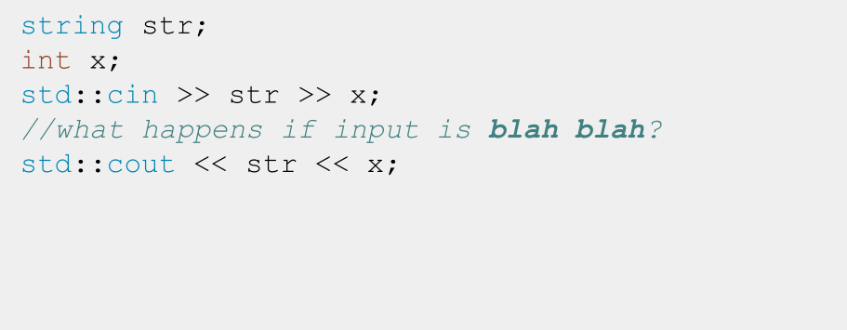
Input Streams: When things go wrong

Slide 32
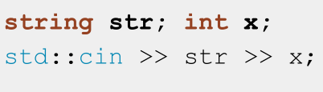
Think of a std::istream as a sequence of characters
b | l | a | h |  | b | l | a | h | \n
position

Slide 33
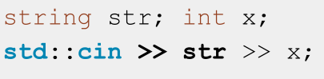
Think of a std::istream as a sequence of characters
b | l | a | h |  | b | l | a | h | \n
position

Slide 34
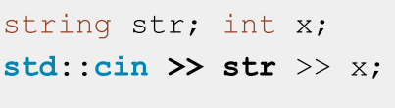
Think of a std::istream as a sequence of characters
b | l | a | h |  | b | l | a | h | \n
position

Slide 35
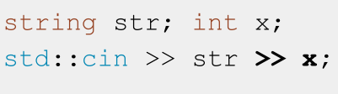
Think of a std::istream as a sequence of characters
b | l | a | h |  | b | l | a | h | \n
position

Slide 36
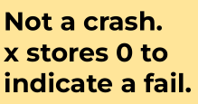
Think of a std::istream as a sequence of characters
FAIL
b | l | a | h |  | b | l | a | h | \n
position

Slide 37
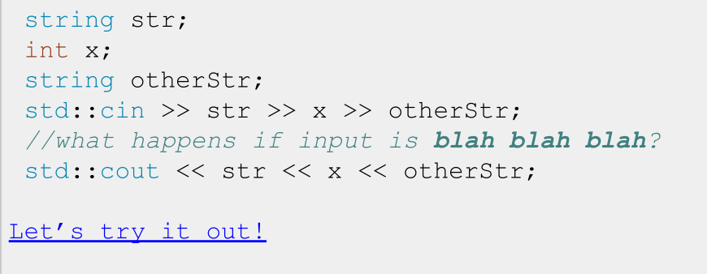
Input Streams: When things go wrong

Slide 38
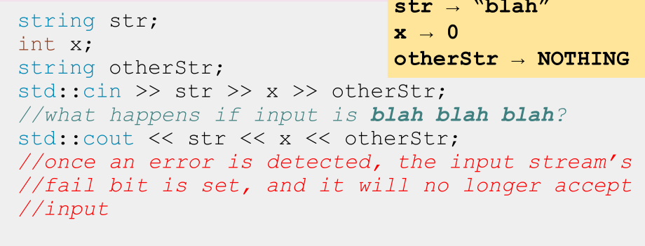
Input Streams: When things go wrong

Slide 39
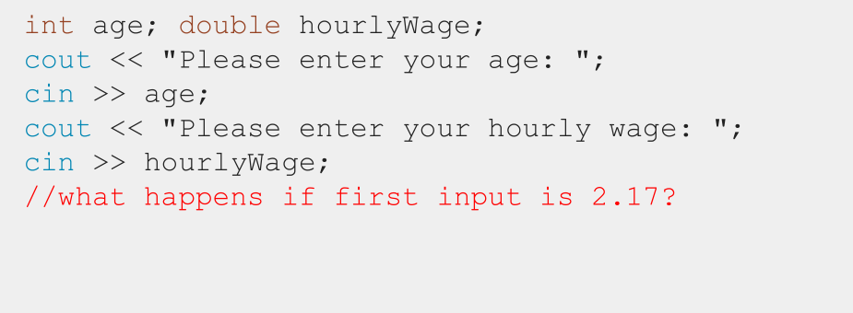
Input Streams: When things go wrong

Slide 40
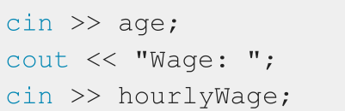
Think of a std::istream as a sequence of characters
2 | . | 1 | 7 | \n
position

Slide 41
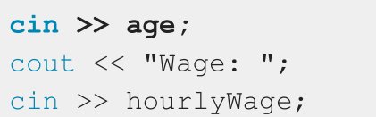
Think of a std::istream as a sequence of characters
2 | . | 1 | 7 | \n
position

Slide 42
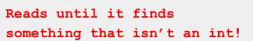
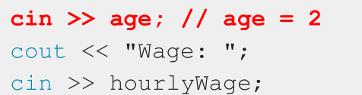
Think of a std::istream as a sequence of characters
2 | . | 1 | 7 | \n
position

Slide 43
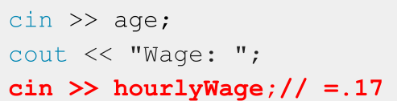
Think of a std::istream as a sequence of characters
2 | . | 1 | 7 | \n
position

Slide 44
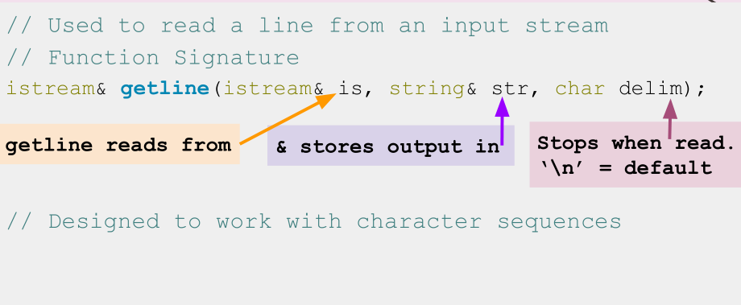
std::getline()

Slide 45
std::getline(istream& is, string& str, char delim)
- How it works:
- Clears contents in str
- Extracts chars from is and stores them in str until:
- End of file reached, sets EOF bit (checked using is.eof())
- Next char in is is delim, extracts but does not store delim
- str out of space, sets FAIL bit (checked using is.fail())
- If no chars extracted for any reason, FAIL bit set

Slide 46
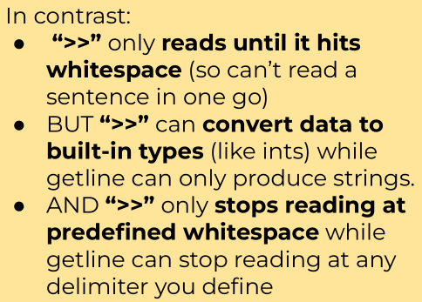
std::getline(istream& is, string& str, char delim)
- How it works:
- Clears contents in str
- Extracts chars from is and stores them in str until:
- End of file reached, sets EOF bit (checked using is.eof())
- Next char in is is delim, extracts but does not store delim
- str out of space, sets FAIL bit (checked using is.fail())
- If no chars extracted for any reason, FAIL bit set

Slide 47
Reading using >> extracts a single “word” or
built-in type
including for strings
To read a whole line, use
std::getline(istream& stream, string& line);

Slide 48
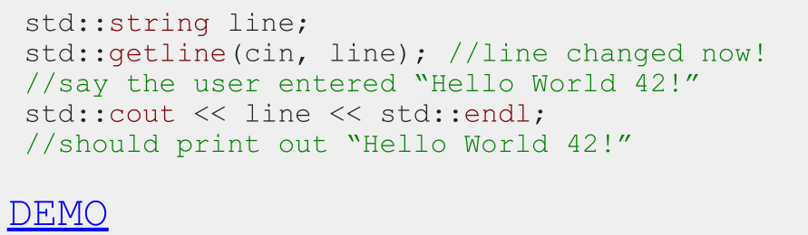
How to use getline
- Notice getline(istream& stream, string&line)takes in both parameters by reference!

Slide 49
IMPORTANT: Don’t mix >> with getline!
- >> reads up to the next whitespace character and does not go past that whitespace character.
- getline reads up to the next delimiter (by default, ‘\n’), and does go past that delimiter.
- TL;DR they don’t play nicely
Notes:
TLDR (or TL;DR) is a common internet acronym for “Too Long; Didn’t Read.”
https://www.howtogeek.com/435266/what-does-tldr-mean-and-how-do-you-use-it/

Slide 50
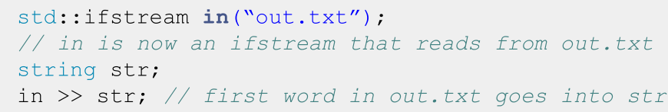
Input File Streams
- Have type std::ifstream
- Only receives strings using the >> operator
- Receives strings from a file and converts it to data of any type
- Must initialize your own ifstream object linked to your file

Slide 51
std::cin is a global constant
object that you get from
#include <iostream>
To use any other input stream, you
must first initialize it!

Slide 52
Streams
- What are streams?
- Output streams
- Input streams
- String streams!

Slide 53
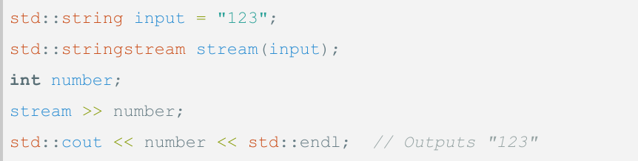
String streams
- What: A stream that can read from or write to
a string object
- Purpose: Allows you to perform input/output
operations on a string as if it were a stream

Slide 54
If you only want to read OR write data:
- Read only: std::istringstream
- Give any data type to the istringstream, it’ll store it as
a string!
- Write only: std::ostringstream
- Make an ostringstream out of a string, read from it word/type by word/type!
- Follows same patterns as the other i/ostreams!

Slide 55
Recap
- Streams convert between data of any type and the string representation of that data
- Streams have an endpoint: console for cin/cout, files for i/o fstreams, string variables for i/o stringstreams where they read in a string from or output a string to.
- To send data (in string form) to a stream, use stream_name << data
- To extract data from a stream, use stream_name >> data, and the stream will try to convert a string to whatever type data is

Slide 56
Containers

Slide 57
Containers
-Defining Containers
What is a container in C++?
- Containers in the STL
Types of containers and how they work
- Container Adaptors
Abstracting container implementation

Slide 58
Container: An object that allows us to
collect other objects together and interact
with them in some way.
Think of vectors, stacks, or queues!

Slide 59
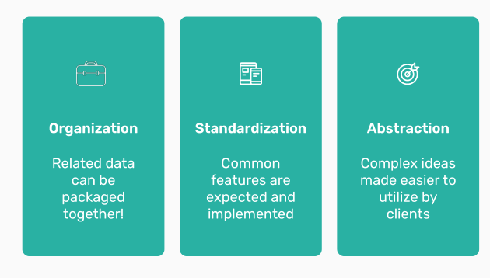
Why
containers?
What is the purpose of
container types in
programming
languages?

Slide 60
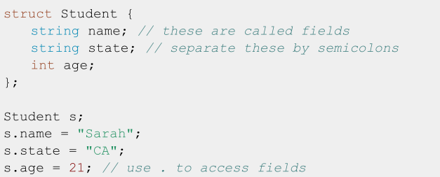

Motivating containers
We’ve been using the idea of a Student struct for the past few lectures:

Slide 61
This is generalizable!
What if we need to store other types of data?
● Class grades
● Coordinates in a graph
● Mountains
What if we want to store it in a different way?
● FIFO vs LIFO
● Ascending order by some value

Slide 62
Containers
-Defining Containers
What is a container in C++?
- Containers in the STL
Types of containers and how they work
- Container Adaptors
Abstracting container implementation

Slide 63

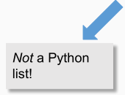
The STL has many types of containers:
Both familiar:
● Vector
● Stack
● Queue
● Set
● Map
And unfamiliar:
● Array
● Deque
● List
● Unordered set
● Unordered map

Slide 64
New containers
● An array is the primitive form of a vector
○ Fixed size in a strict sequence
● A deque is a double ended queue
● A list is a doubly linked list
○ Can loop through in either direction!

Slide 65
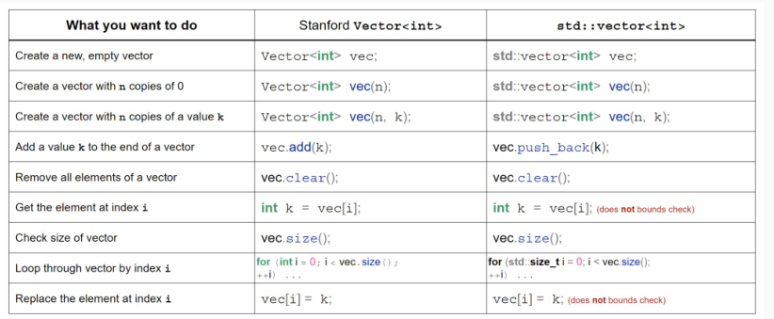
std::vector

Slide 66
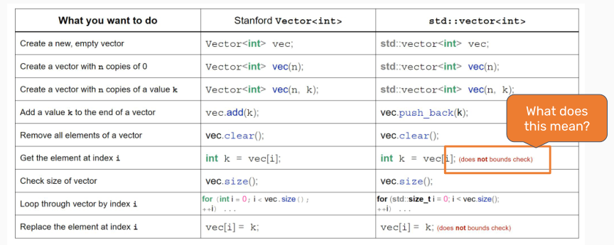
std::vector

Slide 67
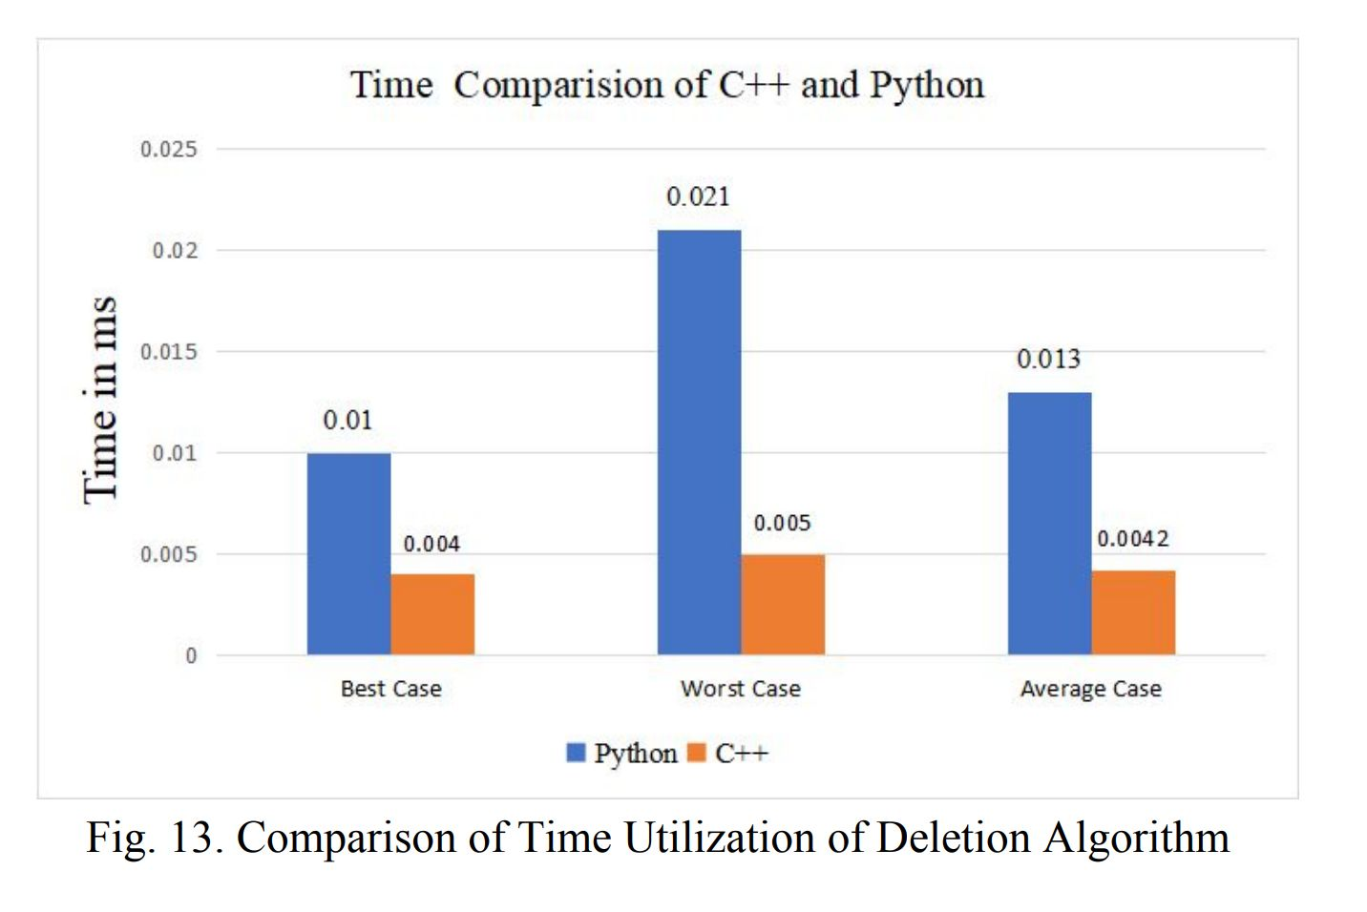
Safety vs Speed
In choosing a programming language, there’s
always a tradeoff between speed, power, and
safety.
C++ is really fast! Why is that?

Slide 68
C++ Design Philosophy
● Only provide the checks/safety nets that are necessary
● The programmer knows best!
Making sure what you’re doing is allowed is your job!

Slide 69
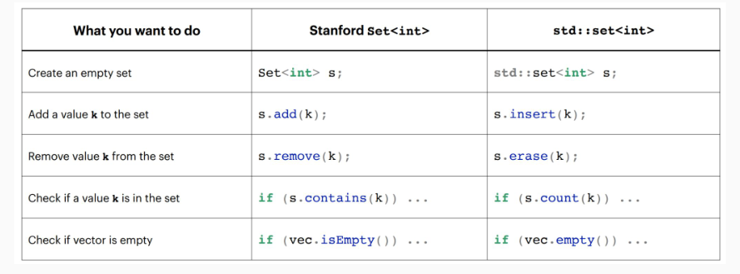
std::set

Slide 70
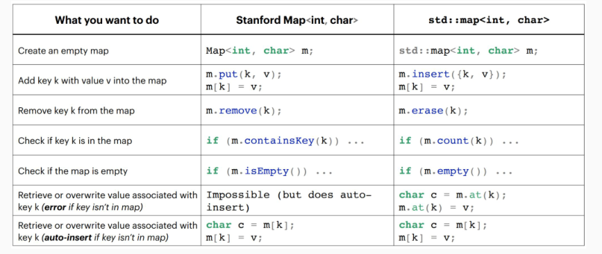
std::map

Slide 71
There are two types of containers:
Sequence:
● Containers that can be accessed sequentially
● Anything with an inherent order goes here!
Associative
● Containers that don’t necessarily
have a sequential order
● More easily searched
● Maps and sets go here!
All containers can hold all types of information! How do we choose which to use?

Slide 72
Vector implementation
How do vectors actually work?
● At a high level, a vector is an ordered collection of
elements of the same type that can grow and shrink in
size.
Internally, vectors implement an array!

Slide 73
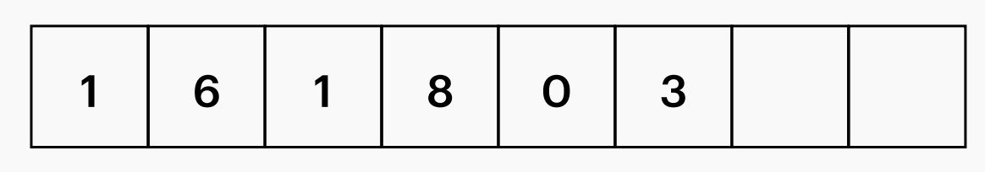
Vector implementation
We keep track of a few member variables:
● _size = number of elements in the vector
● _capacity = space allocated for elements
Don’t confuse these two!

Slide 74
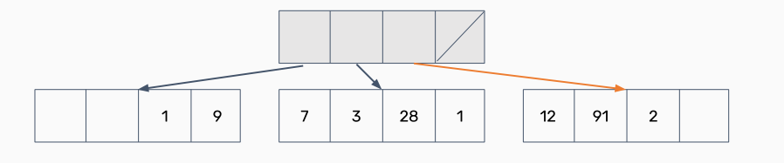
What about a deque?
Deques can be implemented many different ways! Here’s one:
● What if we had an array that stored other arrays?

Slide 75
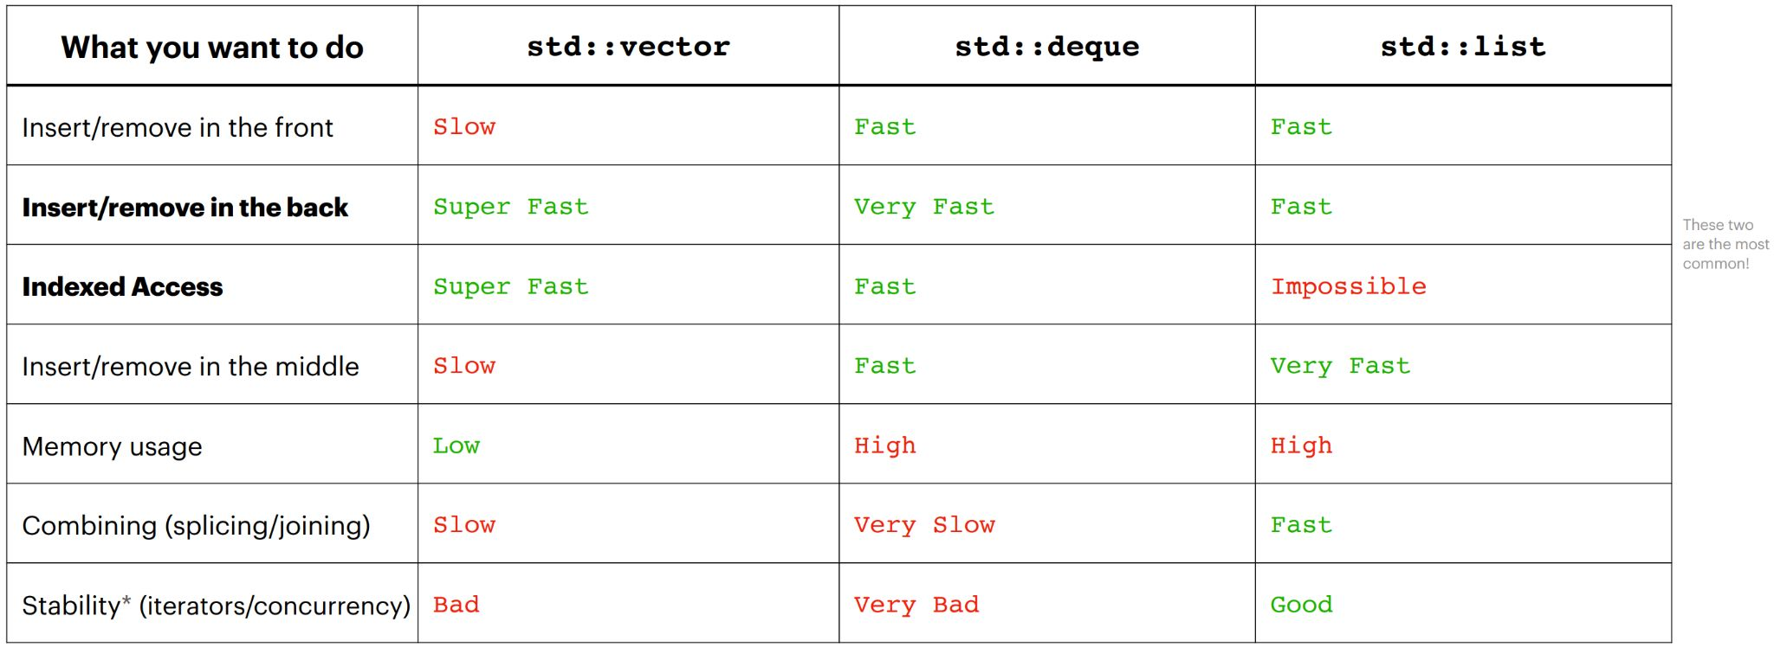
Choosing sequence containers

Slide 76
Sequence Containers: Summary
● Sequence containers are for when you need to enforce
some order on your information!
● Can usually use an std::vector for most anything
● If you need particularly fast inserts in the front, consider
an std::deque
● For joining/working with multiple lists, consider an
std::list (very rarely)

Slide 77
Map implementation
Maps are implemented with pairs! (std::pair<const key, value>)
● Note the const! Keys must be immutable.
● Why a pair and not a tuple?

Slide 78
Unordered maps/sets
Both maps and sets in the STL have an unordered version!
● Ordered maps/sets require a comparison operator
to be defined.
● Unordered maps/sets require a hash function to be
defined.
Unordered maps/sets are usually faster than ordered ones!
Simple types are already natively supported; anything
else will need to be defined yourself.

Slide 79
Choosing associative containers
Lots of similarities between maps/sets! Broad tips:
● Unordered containers are faster, but can be difficult to get to work with nested containers/collections
● If using complicated data types/unfamiliar with hash functions, use an ordered container

Slide 80
So far:
● Sequence containers:
○ Arrays, vectors, deques, lists
● Associative containers:
○ Sets and maps
○ Unordered vs. ordered

Slide 81
Containers
-Defining Containers
What is a container in C++?
- Containers in the STL vs Stanford
Types of containers and how they work
- Container Adaptors
Abstracting container implementation

Slide 82
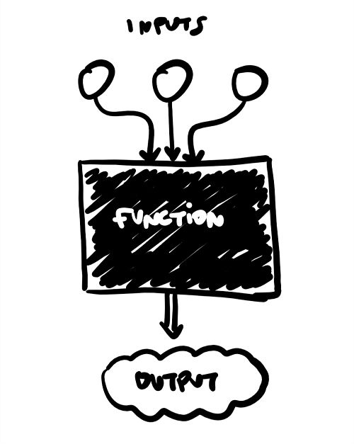
Container Adaptors
Container adaptors are “wrappers” to existing containers!
● Wrappers modify the interface to sequence
containers and change what the client is allowed to
do/how they can interact with the container.
● How could we make a wrapper to implement a queue
from a deque?

Slide 83
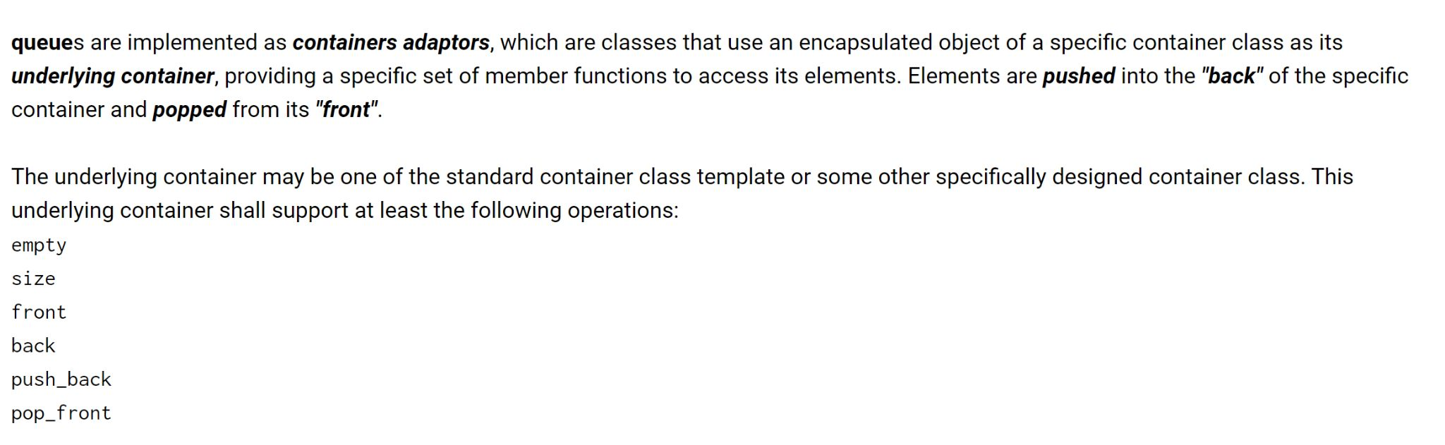
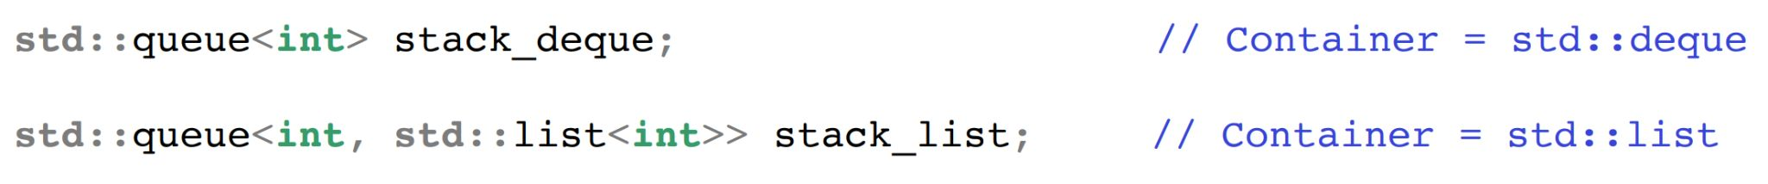
Let’s ask the STL!

Slide 84
Summary
● Containers are ways to collect related data together
and work with it logically
● Two types of containers: sequence and associative
● Container adaptors wrap existing containers to permit
new/restrict access to the interface for the clients.

Slide 85
Coding for love, Coding for the world
Qijun Zhao
qjzhao@scu.edu.cn

